Slide 1


Social
Buzz
Activity analysis

Slide 2


Today's agenda
Project recap : The project involved the study of data to check what kind of content is increasing the business and which categories are holding more importance than the others.
Problem : The client has reached a massive scale within recent years and does not have the resources internally to handle it.
The Analytics team: Our team did a detailed analysis of sample data sets with visualizations to understand the popularity of different content categories.
Process: We did a analysis of data to find out which categories a re performing better than others and contributing to maximum profit.
Summary: We will be sharing some insights on the basis of which some data driven decisions can be made for making the social buzz a better platform.

Slide 3
Project Recap
Social Buzz is a fast growing social media platform that needs to handle its rapidly expanding data. Accenture has begun a detailed data analysis focusing on the tasks such as :
•An audit of Social Buzz's big data practice
•Recommendations for a successful IPO
•Analysis to find Social Buzz's top 5 most popular categories of available content

Slide 4

s
Problem
The client has reached a massive scale within recent years and does not have the resources internally to handle it.
Social Buzz receives over 100000 posts per day which amounts 36,500,000 posts every year, of which this all unstructured data making it very hard to make a sense.
Identify the requirements that need to be delivered for this project.
Creation of sample data set tables that can give us results.
An analysis of their content categories that highlights the top categories with the largest aggregate popularity on the basis of scores.

Slide 5



Andrew Fleming
Chief Technology Architect
The Analytics team
Marcus Rompton
Senior Principal
Kanika Bhargav
Data Analyst

Slide 6
Process
1 Studying the data
2 Data cleaning
3 Data modelling
4 Data analysis
5 Extracting insights

Slide 7

Insights
16 unique content categories
4 types of content, majority of content inform of images
16 types of reactions, majority express positive sentiment
Most popular category is animals
Least popular category is public speaking

Slide 8
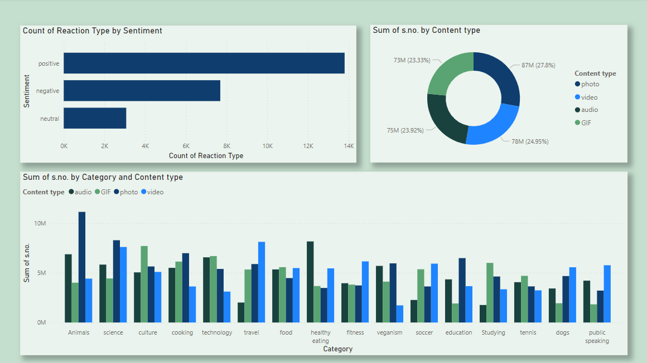

Slide 9
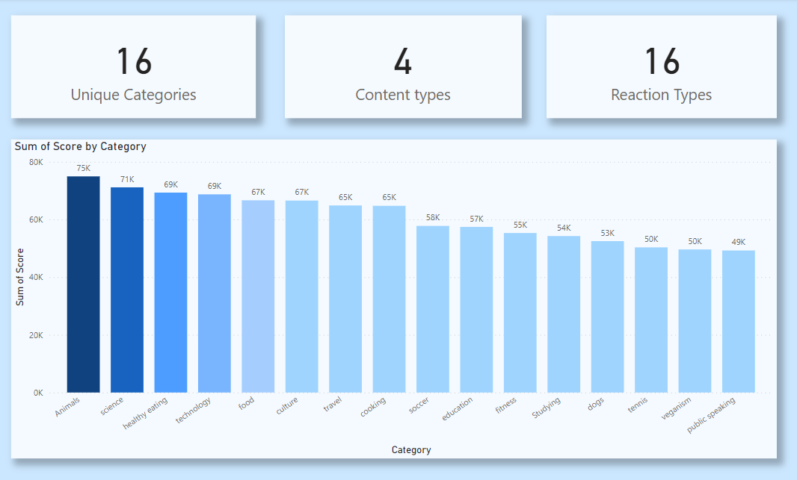

Slide 10
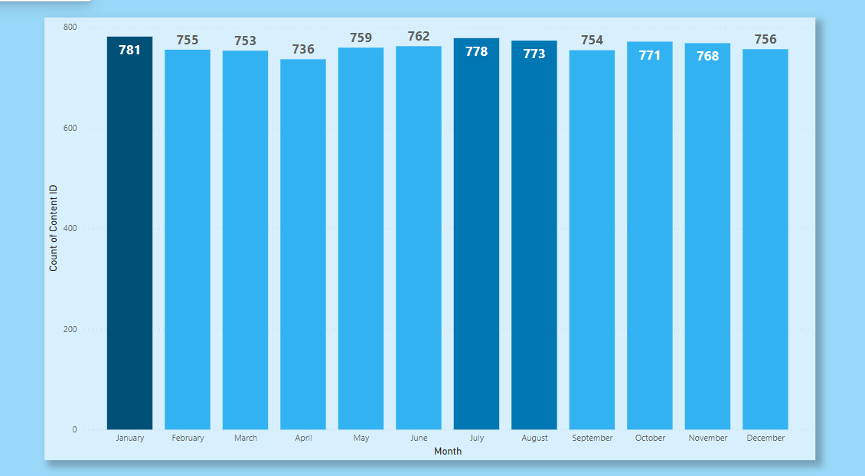

Slide 11
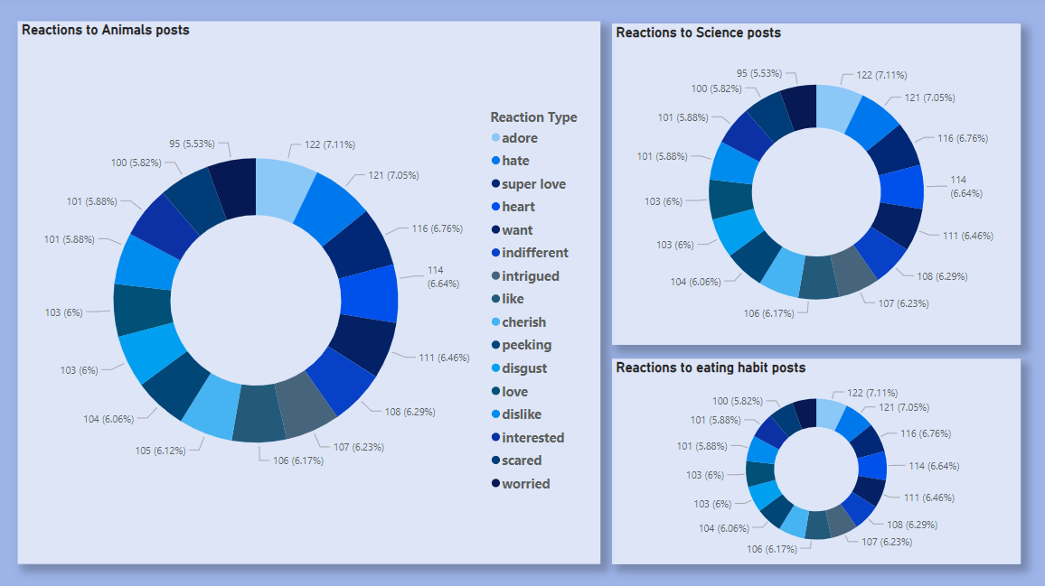

Slide 12

Animals and science are two of the most popular content categories, indicating that users appreciate “real-life” and “factual” content the most. Recommendation would be to include more content related to these two categories.
Within top 5 categories, Food is a theme related to two categories, i.e “food” and “healthy eating”. Recommendation would be to collaborate with food brands to increase the user interaction.
Summary
With rise in interest technology it is no surprise to see contents related to technology within the top categories. It show users enjoy your technology content. Recommendation would be encouraging young tech enthusiasts and collaborating with some of the world’s tech giants as this would definitely enhance user engagement.

Slide 13

Thank you!
ANY QUESTIONS?

